Slide 1
Linear Data Structure (Linked List)
Source: Internet, NPTEL, reference book etc.

Slide 2
Linked Storage Representation
There are many applications where sequential allocation method is unacceptable because of following characteristics
Unpredictable storage requirement
Extensive manipulation of stored data
One method of obtaining the address of node is to store address in computer’s main memory, we refer this addressing mode as pointer of link addressing.
A simple way to represent a linear list is to expand each node to contain a link or pointer to the next node. This representation is called one-way chain or Singly Linked Linear List.

Slide 3
Array: Contagious Storage
In arrays
elements are stored in a contagious memory locations
Arrays are static data structure unless we use dynamic memory allocation
Arrays are suitable for
Inserting/deleting an element at the end.
Randomly accessing any element.
Searching the list for a particular value.

Slide 4
Linked Storage Representation
Head
NULL Value
Last Node
A
1000
B
2050
C
3335
D
5000
1000
2050
3335
A linked List
The linked allocation method of storage can result in both efficient use of computer storage and computer time.
A linked list is a non-sequential collection of data items.
Each node is divided into two parts, the first part represents the information of the element and the second part contains the address of the next mode.
The last node of the list does not have successor node, so null value is stored as the address.
It is possible for a list to have no nodes at all, such a list is called empty list.
There is a pointer (called header) points the first element (also called node)

Slide 5
Array versus Linked Lists
In Linked lists
adjacency between any two elements are maintained by means of links or pointers
It is essentially a dynamic data structure
Linked lists are suitable for
Inserting an element at any position.
Deleting an element from any where.
Applications where sequential access is required.
In situations, where the number of elements cannot be predicted beforehand.

Slide 6
Pros & Cons of Linked Allocation
Insertion Operation
We have an n elements in list and it is required to insert a new element between the first and second element, what to do with sequential allocation & linked allocation?
Insertion operation is more efficient in Linked allocation.
A
1000
B
2050
C
3335
D
5000
1000
2050
3335
A
2100
B
2050
C
3335
D
5000
1000
2050
3335
X
1000
2100

Slide 7
Pros & Cons of Linked Allocation
Deletion Operation
Deletion operation is more efficient in Linked Allocation
A
1000
B
2050
C
3335
D
5000
1000
2050
3335
A
2050
B
2050
C
3335
D
5000
1000
2050
3335

Slide 8
Pros & Cons of Linked Allocation
Search Operation
If particular node in the list is required, it is necessary to follow links from the first node onwards until the desired node is found, in this situation it is more time consuming to go through linked list than a sequential list.
Search operation is more time consuming in Linked Allocation.
Join Operation
Join operation is more efficient in Linked Allocation.
A
1000
B
2050
C
3335
D
5050
5000
1000
2050
3335
12
580
52
5096
15
5145
100
5050
580
5096
5145

Slide 9
Pros & Cons of Linked Allocation
Split Operation
Split operation is more efficient in Linked Allocation
Linked list require more memory compared to array because along with value it stores pointer to next node.
Linked lists are among the simplest and most common data structures. They can be used to implement other data structures like stacks, queues, and symbolic expressions, etc…
A
1000
B
2050
C
3335
D
5000
1000
2050
3335
A
1000
B
2050
C
3335
D
5000
1000
2050
3335

Slide 10
Operations & Type of Linked List
Operations on Linked List
Types of Linked List
Insert
Insert at first position
Insert at last position
Insert into ordered list
Delete
Traverse list (Print list)
Copy linked list
Singly Linked List
Circular Linked List
Doubly Linked List

Slide 11
Singly Linked List
A
next
B
next
C
next
D
NULL
FIRST
It is basic type of linked list.
Each node contains data and pointer to next node.
Last node’s pointer is null.
First node address is available with pointer variable FIRST(or START).
Limitation of singly linked list is we can traverse only in one direction, forward direction.

Slide 12
Node Structure of Singly List
Info
next
Accessing Part
of Node
Info (Node)
Link (Node)
Typical Node
Node
Data
Pointer to Next Node
struct node
{
int info;
struct node *next;
};
C Structure to represent a node

Slide 13
Algorithms for singly linked list
Insert at first position
Insert at last position
Insert in Ordered Linked list
Delete Element
Copy Linked List

Slide 14
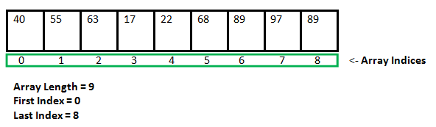
Malloc function
An array is a collection of items stored at contiguous memory locations.
As can be seen, the length (size) of the array above is 9. But what if there is a requirement to change this length (size)? For example,
If there is a situation where only 5 elements are needed to be entered in this array. In this case, the remaining 4 indices are just wasting memory in this array. So there is a requirement to lessen the length (size) of the array from 9 to 5.
Take another situation. In this, there is an array of 9 elements with all 9 indices filled. But there is a need to enter 3 more elements in this array. In this case, 3 indices more are required. So the length (size) of the array needs to be changed from 9 to 12

Slide 15
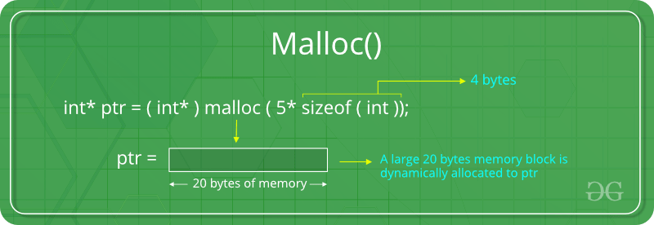
Malloc function
The “malloc” or “memory allocation” method in C is used to dynamically allocate a single large block of memory with the specified size. It returns a pointer of type void which can be cast into a pointer of any form.
In our case we want to create new node which is having structure(data+next pointer)
ptr = (cast-type*) malloc(byte-size)
ptr = (node*) malloc(sizeof(node))

Slide 16
Function: INSERT(X, First)
This function inserts a new node at the first position of Singly linked list.
This function returns address of FIRST node.
X is a new element to be inserted.
FIRST is a pointer to the first element of a Singly linked linear list.
Typical node contains INFO and NEXT fields.
NEW is a temporary pointer variable.

Slide 17
Function: INSERT(X,FIRST) Cont…
1. [Obtain address of new Node in NEW pointer]
NEW ← (node*) malloc(sizeof(node))
2. [Initialize fields of new node and its link to the list]
NEW->INFO ← X
NEW->NEXT ← FIRST
3. [Return address of new node]
Return (NEW)

Slide 18
Example: INSERT(50, FIRST)
50
link
10
link
50
link
35
link
20
NEW
FIRST
FIRST ← INSERT (X, FIRST)
2. [Initialize fields of new node and its link to the list]
NEW->INFO ← X
NEW->NEXT ← FIRST
3. [Return address of new node]
Return (NEW)

Slide 19
Function: INSEND(X, FIRST)
This function inserts a new node at the last position of linked list.
This function returns address of FIRST node.
X is a new element to be inserted.
FIRST is a pointer to the first element of a Singly linked linear list.
Typical node contains INFO and NEXT fields.
NEW is a temporary pointer variable.

Slide 20
Function: INSEND(X, First) Cont…
1. [Obtain address of new Node in NEW pointer]
NEW ← (node*) malloc(sizeof(node))
2. [Initialize fields of new node and its link to the list]
NEW->INFO ← X
NEW->NEXT ← NULL(because it will become the last node)
3. [Search for end of list]
TEMP ← FIRST (use TEMP pointer to traverse last node starting from FIRST node address)
Repeat while TEMP->NEXT ≠ NULL
TEMP ← TEMP->NEXT
4. [Set link field of last node to NEW]
TEMP->NEXT ← NEW

Slide 21
Function: INSEND(50, FIRST)
1. [Obtain address of new Node in NEW pointer]
NEW ← (node*) malloc(sizeof(node))
2. [Initialize fields of new node and its link to the list]
NEW->INFO ← X
NEW->NEXT ← NULL
3. [Search for end of list]
TEMP ← FIRST
Repeat while TEMP->NEXT ≠ NULL
TEMP ← TEMP->NEXT
4. [Set link field of last node to NEW]
TEMP->NEXT ← NEW
TEMP
10
50
-1
8
35
44
50
NEW
FIRST

Slide 22
Function: INSORD(X, FIRST)
This function inserts a new node such that linked list preserves the ordering of the terms in increasing order of their INFO field.
This function returns address of FIRST node.
X is a new element to be inserted.
FIRST is a pointer to the first element of a Singly linked linear list.
Typical node contains INFO and NEXT fields.
NEW is a temporary pointer variable.
Predecessor
5
10
15
20
25
30
FIRST
22
NEW

Slide 23
Function: INSORD(X, FIRST)
1. [Obtain address of new Node in NEW pointer]
NEW ← (node*) malloc(sizeof(node))
2. [Initialize fields of new node and its link to the list]
NEW->INFO ← X
NEW->NEXT ← NULL (initially null)
3. [If new node info is smallest and needs to be added in the first position]
IF NEW->INFO ≤ FIRST->INFO
THEN NEW->NEXT ← FIRST
Return (NEW)
4. [Initialize temporary pointer]
TEMP ← FIRST
5. [Search for predecessor of new node]
Repeat while TEMP->NEXT ≠ NULL
& NEW->INFO ≥ (TEMP->NEXT)->INFO
TEMP ← TEMP->NEXT
6. [Set link field of NEW node and its predecessor]
NEW->NEXT ← TEMP->NEXT
TEMP->NEXT ← NEW
7. [Return first node pointer]
Return (FIRST)

Slide 24
Function: INSORD(3, FIRST)
5
10
15
20
25
30
FIRST
3
NEW
3. [If new node info is smallest and needs to be added in the first position]
IF NEW->INFO ≤ FIRST->INFO
THEN NEW->NEXT ← FIRST
Return (NEW)

Slide 25
Function: INSORD(22, FIRST)
4. [Initialize temporary pointer]
TEMP ← FIRST
5. [Search for predecessor of new node]
Repeat while TEMP->NEXT ≠ NULL
& NEW->INFO ≥ (TEMP->NEXT)->INFO
TEMP ← TEMP->NEXT
6. [Set link field of NEW node and its predecessor]
NEW->NEXT ← TEMP->NEXT
TEMP->NEXT ← NEW
7. [Return first node pointer]
Return (FIRST)
TEMP
5
10
15
20
25
30
FIRST
22
NEW

Slide 26
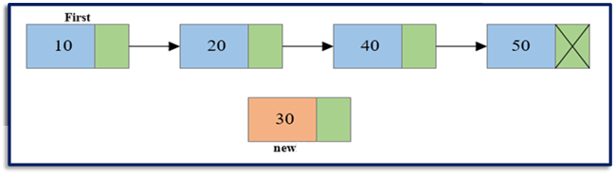
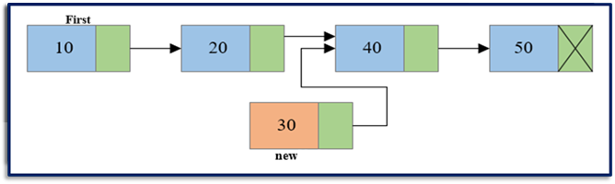
Insert at ANY position
Steps to insert node at any position of Singly Linked List
Step 1: Create a new node.
Step 2: Traverse to the n-1th position of the linked list and connect the new node with the n+1th node. (new →next = temp->next) where temp is the n-1th node.

Slide 27
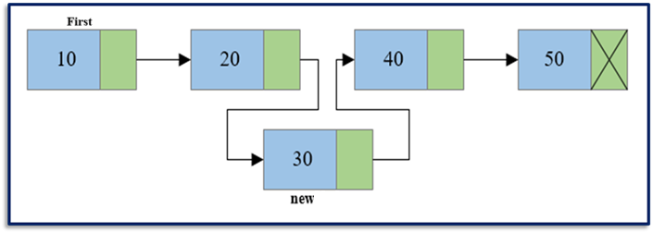
Step 3: Now at last connect the n-1th node with the new node i.e. the n-1th node will now point to new node. (temp->next = new) where temp is the n-1th node.
for(i=1; i< position-1; i++)
{
temp = temp->next;
if(temp == NULL)
break;
}
if(temp != NULL)
{
new->next = temp->next;
temp->next = new;
}else
printf(“Unable to insert”);

Slide 28
Procedure: DELETE(X, FIRST)
This algorithm delete a node whose value is given by variable X.
FIRST is a pointer to the first element of a Singly linked linear list.
Typical node contains INFO and NEXT fields.
TEMP is the temporary pointer variable.
TEMP
TEMP->NEXT
5
10
15
20
25
30
FIRST

Slide 29
Procedure: DELETE( X, FIRST)
1. [Is Empty list?]
IF FIRST = NULL
THEN write (‘Underflow’)
Return
2. [Initialize search for X]
TEMP ← FIRST
3. [Find X]
Repeat thru step-5
while TEMP->NEXT->INFO ≠ X and
TEMP->NEXT ≠ NULL
TEMP ← TEMP->NEXT
4. [End of the list?]
If TEMP->INFO ≠ X
THEN write (‘Node not found’)
Return
5. [Delete X]
If X = FIRST->INFO
THEN TEMP ← FIRST
FIRST ← FIRST->NEXT
ELSE TEMP2 ← TEMP→NEXT
TEMP->NEXT ← TEMP->NEXT->NEXT
6. [Free Deleted Node]
Free (TEMP2)

Slide 30
Procedure: DELETE(20, FIRST)
4. [End of the list?]
If TEMP->INFO ≠ X
THEN write (‘Node not found’)
Return
5. [Delete X]
If X = FIRST->INFO
THEN TEMP ← FIRST
FIRST ← FIRST->NEXT
ELSE TEMP2 ← TEMP→NEXT
TEMP->NEXT ← TEMP->NEXT->NEXT
6. [Free Deleted Node]
Free (TEMP2)
2. [Initialize search for X]
TEMP ← FIRST
3. [Find X]
Repeat thru step-5
while TEMP->NEXT->INFO ≠ X and
TEMP->NEXT ≠ NULL
TEMP ← TEMP->NEXT
TEMP
5
10
15
20
25
30
4455
8564
7541
1254
3254
5000
FIRST

Slide 31
Function: COUNT_NODES(FIRST)
This function counts number of nodes of the linked list and returns COUNT.
FIRST is a pointer to the first element of a Singly linked linear list.
Typical node contains INFO and NEXT fields.
TEMP is a Temporary pointer variable.
1. [Is list Empty?]
IF FIRST = NULL
Then COUNT ← 0
Return(COUNT)
2. [Initialize loop for a last node to update count]
TEMP ← FIRST
3. [Go for end of list]
Repeat while TEMP->NEXT ≠ NULL
TEMP ← TEMP->NEXT
COUNT ← COUNT + 1
4. [Return Count]
Return (COUNT)

Slide 32
Function: COPY (FIRST)
This function Copy a Link List and creates new Linked List
This function returns address of first node of newly created linked list.
The new list is to contain nodes whose information and pointer fields are denoted by FIELD and PTR, respectively.
The address of the first node in the newly created list is to be placed in FIRST2.(i.e. second linklist)
FIRST1 is a pointer to the first element of a Singly linked linear list.
Typical node contains INFO and NEXT fields.
NEW, TEMP1 and TEMP2 are temporary pointer variables.

Slide 33
Function: COPY (FIRST)
1. [Is Empty list?]
IF FIRST1 = NULL
Return(NULL)
ELSE
2. [Initialize Traversal and the first node is copied]
TEMP1 ← FIRST1
NEW ← new node created
NEW->INFO ← FIRST1->INFO
FIRST2 ← NEW
TEMP2 ← FIRST2
3. [Move to the next node and copy node]
While TEMP1->NEXT ≠ NULL
TEMP1 ← TEMP1->NEXT
NEW ← new node created
NEW->INFO ← TEMP1->INFO
TEMP2->NEXT ← NEW
TEMP2 ← TEMP2->NEXT
4. [Return second list]
RETURN(FIRST2)

Slide 34
Function: COPY (FIRST)
2. [Initialize Traversal and the first node is copied]
TEMP1 ← FIRST1
NEW ← new node created
NEW->INFO ← FIRST1->INFO
FIRST2 ← NEW
TEMP2 ← FIRST2
3. [Move to the next node and copy node]
While TEMP1->NEXT ≠ NULL
TEMP1 ← TEMP1->NEXT
NEW ← new node created
NEW->INFO ← TEMP1->INFO
TEMP2->NEXT ← NEW
TEMP2 ← TEMP2->NEXT
4. [Return second list]
RETURN(FIRST2)
FIRST1
TEMP1
5
10
15
30
FIRST2
TEMP2
5
10
15
30
NEW
NEW
NEW
NEW

Slide 35
Comparing two Lists
Comparing two linked list includes
Identifying whether the given two linked list are identical.
Two Linked Lists are identical when they have same data and arrangement of data is also same.
Checking whether the lists have same values when the arrangement is not same.

Slide 36
bool areIdentical(struct node *a, struct node *b)
{
while (a != NULL && b != NULL)
{
if (a->data != b->data)
return false;
/* If we reach here, then a and b are not NULL and their data is same, so move to next nodes in both lists */
a = a->next;
b = b->next;
}
//If linked lists are identical, then 'a' and 'b' must be NULL at this point.
return (a == NULL && b == NULL);
}
int main()
{
struct node *a, *b;
a = createList(5); // e.g: a: 5->4->3->2->1
b = createList(5); // e.g: b: 5->4->3->2->1
areIdentical(a, b)? printf("Identical"): printf("Not identical");
return 0;
}

Slide 37
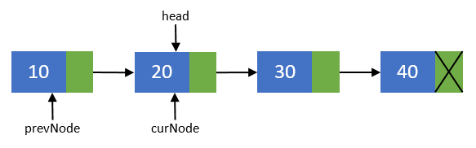
Reversing Link List: Iterative method
Reversing a list can be performed in two ways:
Iterative method
Recursive method
Steps to reverse a Singly Linked List using Iterative method
Step 1: Create two more pointers other than head namely prevNode and curNode that will hold the reference of previous node and current node respectively.
Make sure that prevNode points to first node i.e. prevNode = head.
head should now point to its next node i.e. head = head->next.
curNode should also points to the second node i.e. curNode = head.

Slide 38
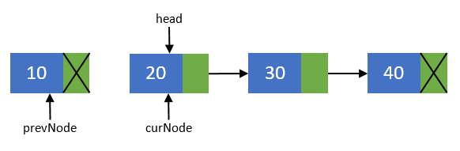
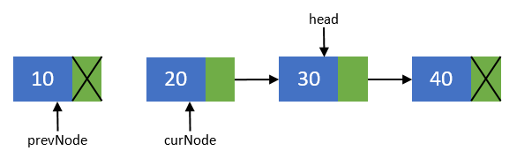
Step 2: Now, disconnect the first node from others. We will make sure that it points to none. As this node is going to be our last node. Perform operation prevNode->next = NULL
Step 3: Move the head node to its next node i.e. head = head->next

Slide 39
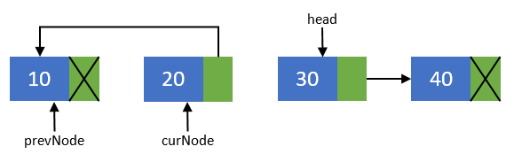
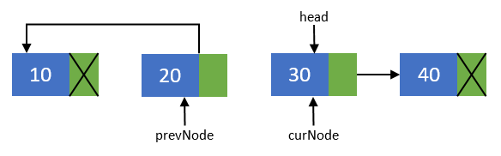
Step 4: Now, re-connect the current node to its previous node i.e. curNode->next = prevNode;
Step 5: Point the previous node to current node and current node to head node. Means they should now point to prevNode = curNode; and curNode = head.

Slide 40
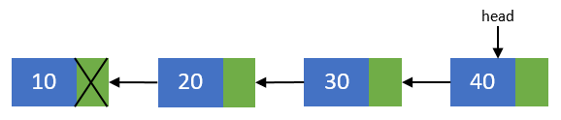
Step 6: Repeat steps 3-5 till head pointer becomes NULL.
Step 7: Now, after all nodes has been re-connected in the reverse order. Make the last node as the first node. Means the head pointer should point to prevNode pointer.
Perform head = prevNode; And finally you end up with a reversed linked list of its original.

Slide 41
void reverseList()
{
struct node *prevNode, *curNode;
if(head != NULL)
{
prevNode = head;
curNode = head->next;
head = head->next;
prevNode->next = NULL; //Makes the first node as last node
while(head != NULL)
{
head = head->next;
curNode->next = prevNode;
prevNode = curNode;
curNode = head;
}
head = prevNode; //Makes the last node as head
printf("SUCCESSFULLY REVERSED LIST\n");
}
}

Slide 42
Reverse a Link List: Recursive Method(print only)
void Recursive_Reverse(struct node* head)
{
if (head == NULL) // boundary condition to stop recursion
return;
Recursive_Reverse(head->next); // print the list after head node
printf("%d ", head->data); // After everything else is printed, print head
}
/* It should be called from the main() function as */
int main()
{
int n = 10;
createList(n); // creates 10 nodes in the linked list
Recursive_Reverse(head);
return 0;
}

Slide 43
Reverse a Link List: Recursive Method
Struct node* Recursive_Reverse2(struct node* Node)
{
if (Node == NULL) // Check if the list is empty
return NULL;
if (Node->next==NULL){ // Last node to stop recursion
head=Node; // Make the last node as head
return Node;
}
node* Node1= Recursive_Reverse2(Node->next); // call for next node
Node1->next=Node;
Node->next = NULL;
return Node;
}
/* It should be called from the main() function as */
int main()
{
int n = 10;
createList(n); // creates 10 nodes in the linked list
Recursive_Reverse2(head);
return 0;
}

Slide 44
Example: Student List
struct stud
{
int roll;
char name[30];
int age;
struct stud *next;
};
struct stud n1, n2, n3;
n1.next = &n2 ;
n2.next = &n3 ;
n3.next = NULL ; /* No more nodes follow */
roll
name
age
next
NULL
n1
n2
n3

Slide 45
Circularly Linked Linear List
If we replace NULL pointer of the last node of Singly Linked Linear List with the address of its first node, that list becomes circularly linked linear list or Circular List.
FIRST is the address of first node of Circular List
LAST is the address of the last node of Circular List
Advantages of Circular List
In circular list, every node is accessible from given node
It saves time when we have to go to the first node from the last node. It can be done in single step because there is no need to traverse the in between nodes. But in double linked list, we will have to go through in between nodes
LAST
5
10
15
20
25
30
FIRST

Slide 46
Circularly Linked Linear List Cont…
Disadvantages of Circular List
It is not easy to reverse the linked list.
If proper care is not taken, then the problem of infinite loop can occur.
If we at a node and go back to the previous node, then we can not do it in single step. Instead we have to complete the entire circle by going through the in between nodes and then we will reach the required node.
Operations on Circular List
Insert at First
Insert at Last
Insert in Ordered List
Delete a node

Slide 47
Procedure: CIR_INS_FIRST(X,FIRST,LAST)
This procedure inserts a new node at the first position of Circular linked list.
X is a new element to be inserted.
FIRST and LAST are a pointer to the first & last elements of a Circular linked linear list, respectively.
Typical node contains INFO and NEXT fields.
NEW is a temporary pointer variable.

Slide 48
Procedure: CIR_INS_FIRST(X,FIRST,LAST)
1. [Creates a new empty node]
NEW NODE(malloc call)
2. [Initialize fields of new node and its link]
NEW->INFO ← X
IF FIRST = NULL
THEN NEW->NEXT ← NEW
FIRST ← LAST ← NEW
ELSE NEW->NEXT ← FIRST
LAST->NEXT ← NEW
FIRST ← NEW
Return
FIRST
NEW
FIRST
LAST
50
LAST
50
NEW
5
10
1
-5
FIRST

Slide 49
Procedure: CIR_INS_LAST(X,FIRST,LAST)
This procedure inserts a new node at the last position of Circular linked list.
X is a new element to be inserted.
FIRST and LAST are a pointer to the first & last elements of a Circular linked linear list, respectively.
Typical node contains INFO and LINK fields.
NEW is a temporary pointer variable.

Slide 50
Procedure: CIR_INS_LAST( X,FIRST,LAST)
1. [Creates a new empty node]
NEW NODE
2. [Initialize fields of new node and its link]
NEW->INFO ← X
IF FIRST = NULL
THEN NEW->NEXT ← NEW
FIRST ← LAST ← NEW
ELSE NEW->NEXT ← FIRST
LAST->NEXT ← NEW
LAST ← NEW
Return
LAST
NEW
FIRST
LAST
50
LAST
50
NEW
5
10
1
-5
FIRST

Slide 51
Procedure: CIR_INS_ORD(X,FIRST,LAST)
This function inserts a new node such that linked list preserves the ordering of the terms in increasing order of their INFO field.
X is a new element to be inserted.
FIRST and LAST are a pointer to the first & last elements of a Circular linked linear list, respectively.
Typical node contains INFO and NEXT fields.
NEW is a temporary pointer variable.

Slide 52
Procedure: CIR_INS_ORD(X,FIRST,LAST)
1. [Create New Empty Node]
NEW NODE
2. [Copy information content into new node]
INFO(NEW) ← X
3. [Is Linked List Empty?]
IF FIRST = NULL
THEN NEW->NEXT ← NEW
FIRST ← LAST ← NEW
Return
4. [Does new node data is less than the FIRST node]
IF NEW->INFO ≤ FIRST->INFO
THEN NEW ->NEXT ← FIRST
LAST->NEXT ← NEW
FIRST ← NEW
Return
5. [Initialize Temporary Pointer]
TEMP ← FIRST
6. [Search for Predecessor of new node]
Repeat while TEMP ≠ LAST &
NEW->INFO ≥ (TEMP->NEXT)->INFO
TEMP←TEMP->NEXT
7. [Set link field of NEW node and its Predecessor]
NEW->NEXT ← TEMP->NEXT
TEMP->NEXT← NEW
IF TEMP = LAST
THEN LAST ← NEW
8. [Finished]
Return

Slide 53
Procedure: CIR_INS_ORD(3,FIRST,LAST)
1. [Create New Empty Node]
NEW NODE
2. [Copy information content into new node]
INFO(NEW) ← X
3. [Is Linked List Empty?]
IF FIRST = NULL
THEN NEW->NEXT ← NEW
FIRST ← LAST ← NEW
Return
4. [Does new node data is less than the FIRST node]
IF NEW->INFO ≤ FIRST->INFO
THEN NEW ->NEXT ← FIRST
LAST->NEXT ← NEW
FIRST ← NEW
Return
FIRST
NEW
FIRST
LAST
3
LAST
3
5
10
15
20
NEW
FIRST

Slide 54
Procedure: CIR_INS_ORD(18,FIRST,LAST)
5. [Initialize Temporary Pointer]
TEMP ← FIRST
6. [Search for Predecessor of new node]
Repeat while TEMP ≠ LAST &
NEW->INFO ≥ (TEMP->NEXT)->INFO
TEMP←TEMP->NEXT
7. [Set link field of NEW node and its Predecessor]
NEW->NEXT ← TEMP->NEXT
TEMP->NEXT← NEW
IF TEMP = LAST
THEN LAST ← NEW
8. [Finished]
Return
NEW
18
LAST
TEMP
5
10
15
20
FIRST

Slide 55
Procedure: CIR_DELETE(X,FIRST,LAST)
This algorithm delete a node whose value is given by variable X.
FIRST & LAST are pointers to the First & Last elements of a Circular linked list, respectively.
Typical node contains INFO and NEXT fields.
TEMP temporary pointer variable.

Slide 56
Procedure: CIR_DELETE(X,FIRST,LAST)
1. [Is Empty List?]
IF FIRST = NULL
THEN write(‘Linked List is Empty’)
Return
2. [Initialize Search for X]
TEMP ← FIRST
3. [Find X]
Repeat thru step 4
while TEMP->NEXT->INFO≠X & TEMP≠LAST
4. [Move to next node]
TEMP ← TEMP->NEXT
5. [End of Linked List?]
IF TEMP->INFO ≠ X
THEN write(‘Node not found’)
Return
6. [Delete X]
IF X = FIRST->INFO
THEN TEMP2 ← FIRST
FIRST←FIRST->NEXT
ELSE
TEMP2 ← TEMP->NEXT
TEMP->NEXT←TEMP->NEXT->NEXT
IF TEMP->NEXT = LAST
THEN TEMP2 ←LAST
LAST← TEMP
7. [Free Deleted Node]
Free (TEMP2)

Slide 57
Procedure: CIR_DELETE(20,FIRST,LAST)
1. [Is Empty List?]
IF FIRST = NULL
THEN write(‘Linked List is Empty’)
Return
2. [Initialize Search for X]
TEMP ← FIRST
3. [Find X]
Repeat thru step 4
while TEMP->NEXT->INFO≠X & TEMP≠LAST
4. [Move to next node]
TEMP ← TEMP->NEXT
5. [End of Linked List?]
IF TEMP->INFO ≠ X
THEN write(‘Node not found’)
Return
6. [Delete X]
IF X = FIRST->INFO
THEN TEMP2 ← FIRST
FIRST←FIRST->NEXT
ELSE
TEMP2 ← TEMP->NEXT
TEMP->NEXT←TEMP->NEXT->NEXT
IF TEMP->NEXT = LAST
THEN TEMP2 ←LAST
LAST← TEMP
7. [Free Deleted Node]
Free (TEMP2)
TEMP
5
10
15
20
25
30
4455
8564
7541
1254
3254
5000
FIRST
LAST

Slide 58
Doubly Linked Linear List
In certain Applications, it is very desirable that a list be traversed in either forward or reverse direction.
This property implies that each node must contain two link fields instead of usual one.
The links are used to denote Predecessor and Successor of node.
The link denoting its predecessor is called prev.
The link denoting its successor is called next.
A list containing this type of node is called doubly linked list or two way chain.

Slide 59
Doubly Linked Linear List
Typical node of doubly linked linear list contains INFO, LPTR RPTR Fields
PREV is pointer variable pointing to Predecessor of a node
NEXT is pointer variable pointing to Successor of a node
Left most node of doubly linked linear list is called L, PREV of node L is always NULL
Right most node of doubly linked linear list is called R, NEXT of node R is always NULL
PREV
INFO
NEXT
Typical node of
Doubly Linked List
L
Doubly linked linear list
R

Slide 60
Insert node in Doubly Linked List
Insertion in the middle of Doubly Linked Linear List
Before Insertion
M
L
R
NEW->PREV ← M->PREV
NEW
NEW->NEXT ← M
M->PREV ← NEW
After Insertion
(NEW->PREV)->NEXT ← NEW
M
L
R
NEW

Slide 61
Insert node in Doubly Linked List
Left most insertion in Doubly Linked Linear List
Before Insertion
M
L
R
NEW->PREV ← NULL
NEW->NEXT ← M
NEW
M->PREV ← NEW
L ← NEW
After Insertion
M
L
L
R
NEW

Slide 62
Procedure: DOU_INS (L,R,M,X)
This algorithm inserts a new node in doubly linked linear list.
The insertion is to be performed to the left of a specific node with its address given by the pointer variable M.
Typical node of doubly linked list contains following fields PREV, NEXT and INFO.
PREV is pointer variable pointing to Predecessor of a node.
NEXT is pointer variable pointing to Successor of a node.
L & R are pointer variables pointing for Leftmost and Rightmost node of Linked List.
NEW is the address of New Node.
X is value to be inserted.

Slide 63
Procedure: DOU_INS (L,R,M,X)
1. [Create New Empty Node]
NEW NODE
2. [Copy information field]
NEW->INFO ← X
3. [Insert into an empty list]
IF R = NULL (R is holding the address of the rightmost node if its null, it means list is empty)
THEN NEW->PREV ← NULL
NEW->NEXT ← NULL
L ← R ← NEW
Return
4. [nsertion at beginning]
IF M = L
THEN NEW->PREV ← NULL
NEW->NEXT ← M
M->PREV← NEW
L ← NEW
Return
5. [Insert in middle]
NEW->PREV ← LPTR(M)
NEW->NEXT ← M
M->PREV ← NEW
(NEW->PREV)->NEXT ← NEW
Return

Slide 64
Procedure: DOU_INS (L,R,M,X)
1. [Create New Empty Node]
NEW NODE
2. [Copy information field]
NEW->INFO ← X
3. [Insert into i^{th} position]
TEMP ← L, j←1
while(j!=i)
TEMP←TEMP->NEXT
j←j+1
we reached to one node before the actual one
4. [Insert the node]
NEW->PREV ← TEMP
NEW->NEXT ← TEMP->NEXT
TEMP->NEXT ← NEW
(NEW->NEXT)->PREV) ← NEW
Return

Slide 65
PROCEDURE: DOU _DEL (L, R, OLD)
This algorithm deletes the node whose value is contained in the variable OLD.
Typical node of doubly linked list contains following fields PREV, NEXT and INFO.
PREV is pointer variable pointing to Predecessor of a node.
NEXT is pointer variable pointing to Successor of a node.
L & R are pointer variables pointing for Leftmost and Rightmost node of Linked List.

Slide 66
Delete from Doubly Linked List
10
L ← R ← NULL
OLD
L
R
OLD
OLD
OLD
L
L
R
R
L ← L->NEXT
L->PREV ← NULL
(OLD->PREV)->NEXT ← OLD->NEXT
R ← R->PREV
R->NEXT ← NULL
(OLD->NEXT)->PREV ←OLD->PREV

Slide 67
Procedure: DOU_DEL (L,R,M,X)
1. [Is underflow ?]
IF R=NULL
THEN write (‘UNDERFLOW’)
Return
2. [Delete node]
IF L = R (single node in list)
THEN L ← R ← NULL
3. [Delete left most node]
IF OLD = L (left most node)
THEN L ← L->NEXT
L->PREV ← NULL
4. [Delete right most node]
IF OLD = R (right most)
THEN R ← R->PREV
R->NEXT ← NULL
5. [FREE deleted node ?]
FREE(OLD)
6. [delete i^{th} node]
OLD ← L, j←1
while(j!=i)
OLD←OLD->NEXT
j←j+1
we reached to actual node
7. [Delete the node]
(OLD->PREV)->NEXT ← OLD->NEXT
(OLD->NEXT)->PREV ←OLD->PREV
FREE(OLD)

Slide 68
Time complexity analysis
Array:
Accessing an element at a specific memory address takes O(1) time, as its relative address can be calculated in constant time.
Similarly editing any element of the array takes O(1) time.
Inserting a new element at a particular index in arrays is only possible when we skip all the elements before that index, which takes O(N) time.
Similarly, deletion operation also takes O(N) time.
Searching operation in arrays takes O(N) time without any specific algorithm as we need to iterate and check every element in the array.

Slide 69
Time complexity analysis
Queue:
To access or edit any element stored in a queue, the time taken is O(N) as to reach any specific element, all the elements after it has to be removed.
The searching operation also takes a total time of O(N), as reaching any specific element isn’t possible without popping the elements stored after it.
Operations like insertion or deletion in a queue take constant time i.e., O(1). Only the front element can be removed at a time and insertion can only take place at the back.

Slide 70
Time complexity analysis
Stack:
To access or edit any element stored in a stack, the time taken is O(N) as to reach any specific element, all the elements before it has to be removed.
The searching operation also takes a total time of O(N), as reaching any specific element isn’t possible without popping the elements stored before it.
Operations like insertion or deletion in a stack take constant time i.e. O(1).

Slide 71
Time complexity analysis
Link List:
For insertion in the linked list, the time complexity is O(1) if done on the head, O(N) if done at any other location, as we need to reach that location by traversing the linked list.
For deletion, the time complexity is O(1), if done on the head, O(N), if done at any other location, as we need to reach that location by traversing the linked list.
For searching and accessing any elements, the involved time complexity is O(N).

Slide 72
